Slide 1
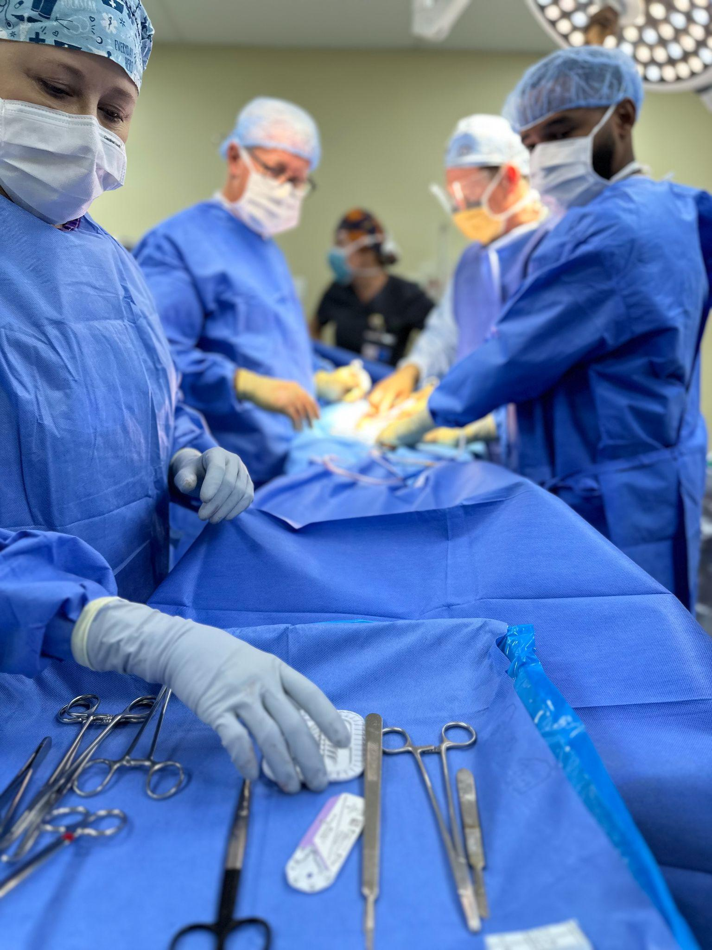
WHY WE GO THERE
TAKING STUDENTS ON MISSION TRIPS
Presented By
Suzi Shippen-Wagner, CST,BS,Program Chair
Renee Bridges, CST,AGE,Program Director

Slide 2
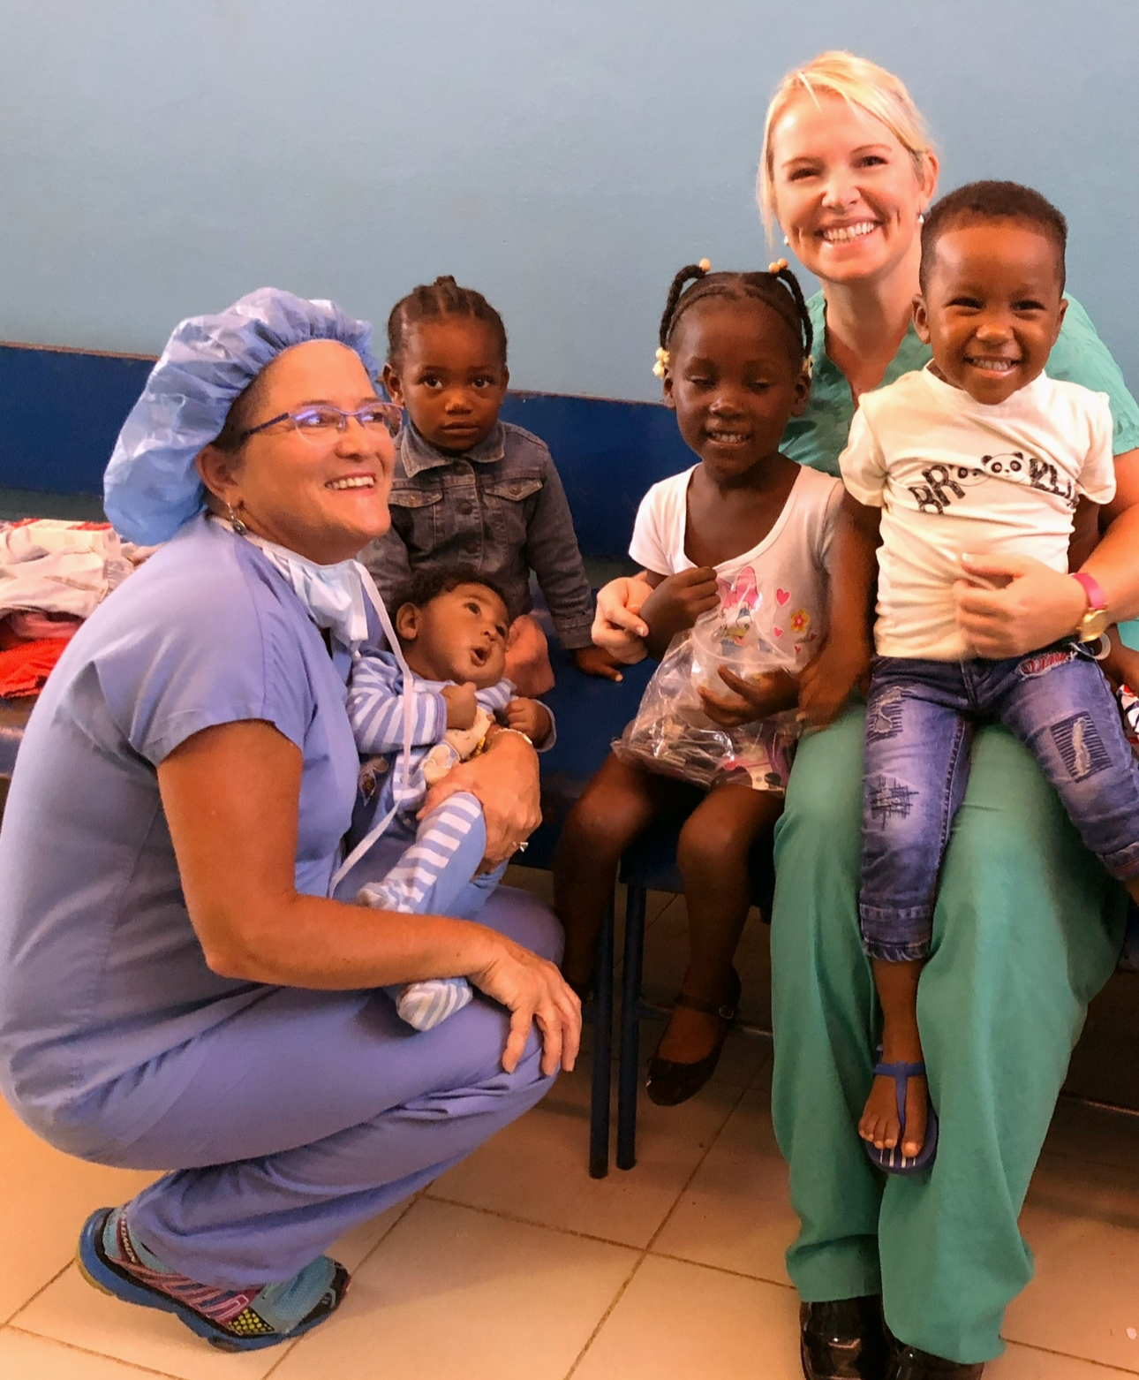
WELCOME!
Renee Bridges, CST, AGE
Program Director at Davidson-Davie Community College (DDCC)
In Lexington, North Carolina
CST For 23 Years (Primarily Trauma)
Started SUR/CSP Program in DDCC In 2015
Joined Pons Dominican Republic Medical Mission
(formerly Midwest Medical Mission) In 2009
Serves As Board Member For PDRMM

Slide 3
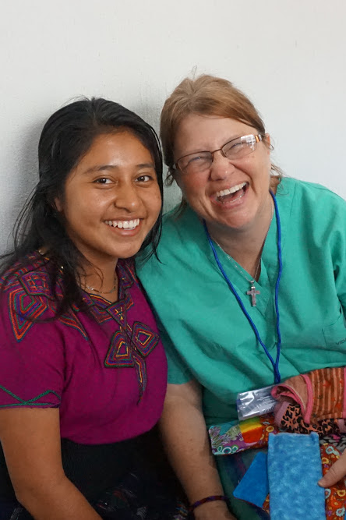
Suzi Shippen-Wagner, CST, BS
Edgecombe Community College
Program Director, Surgical Technology
Rocky Mount, NC for 12 yrs.
CST for 15 yrs. Transplant/Oncology
Mission Team Member for Serving HIM, One World Surgery, & Solid Rock International

Slide 4
OBJECTIVES
Explain why & where we go
Give examples of past experiences
Provide funding information for educators and students

Slide 5

Pons Dominican Republic
Medical Mission
Founders: The Late Dr.Pablo and Maria Pons pictured with daughter Lilia Palmer, Current Director.

Slide 6
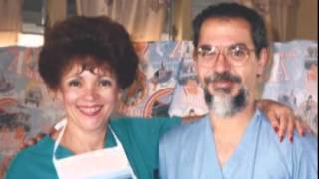
History and Who Do We Serve?

Slide 7
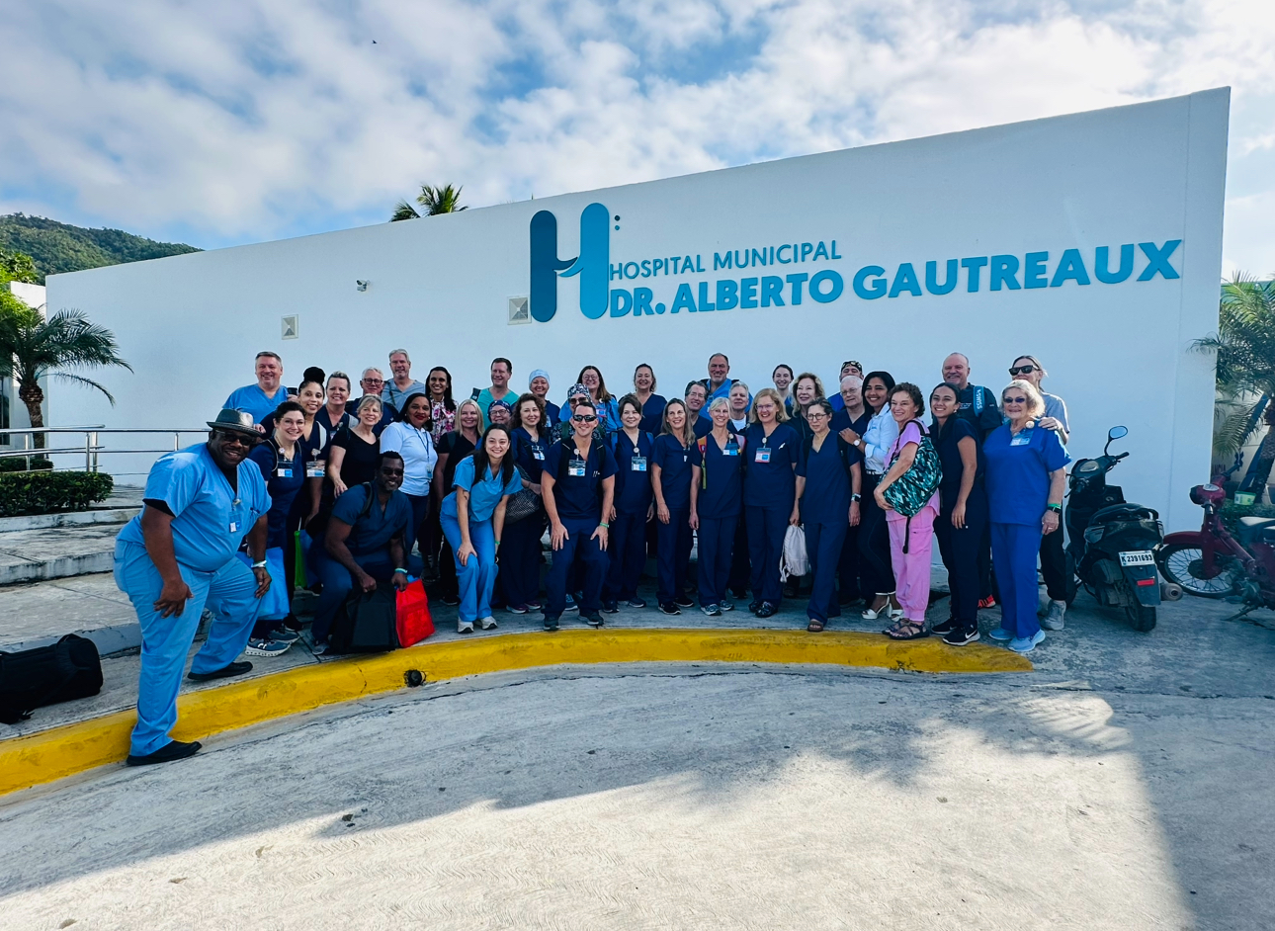
Mission Team consists of Operating Room, Dental, Ophthalmology, Clinic,and Prosthetic Teams.

Slide 8
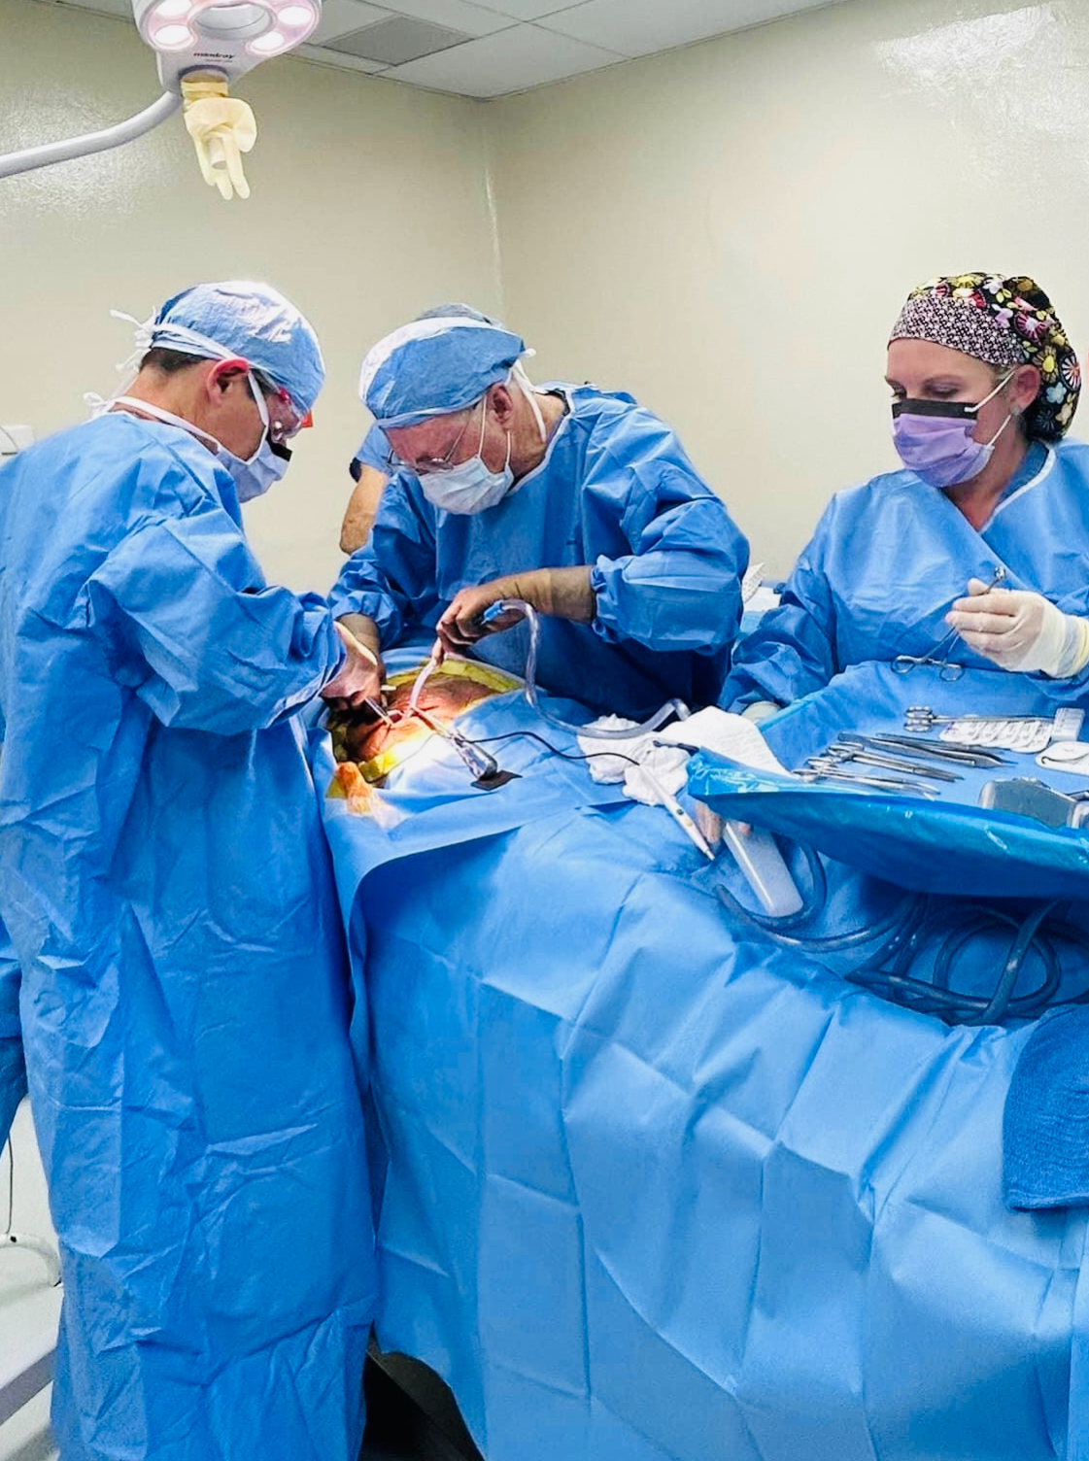
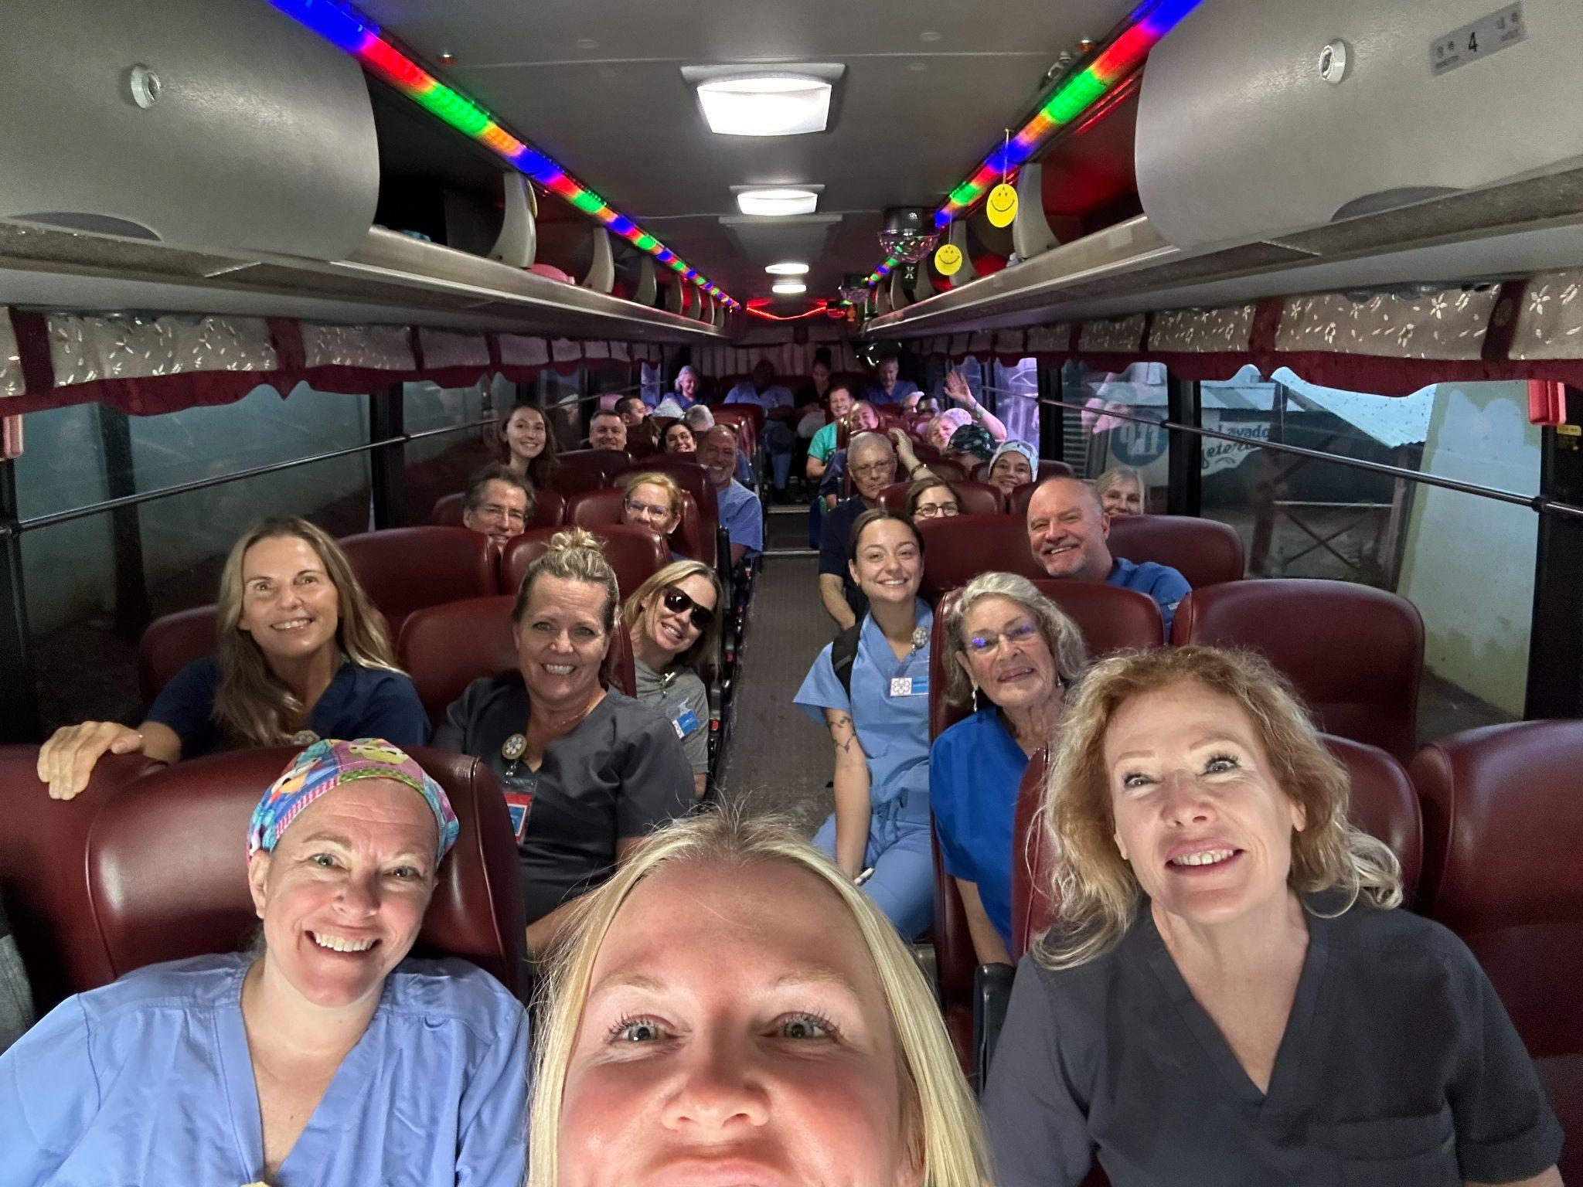

Slide 9
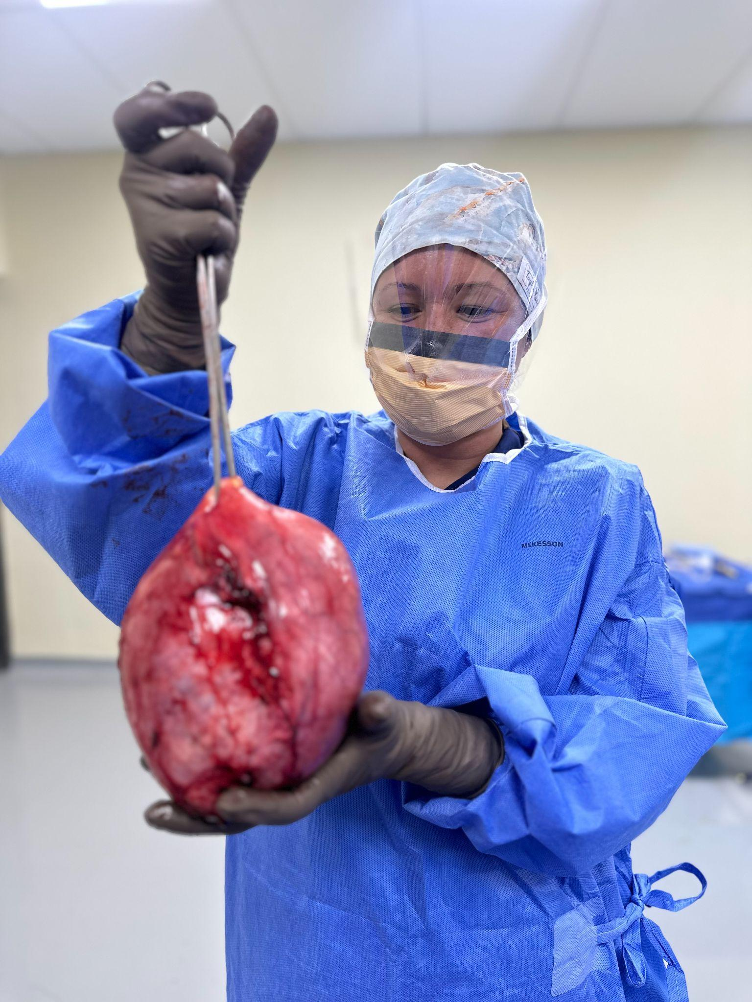
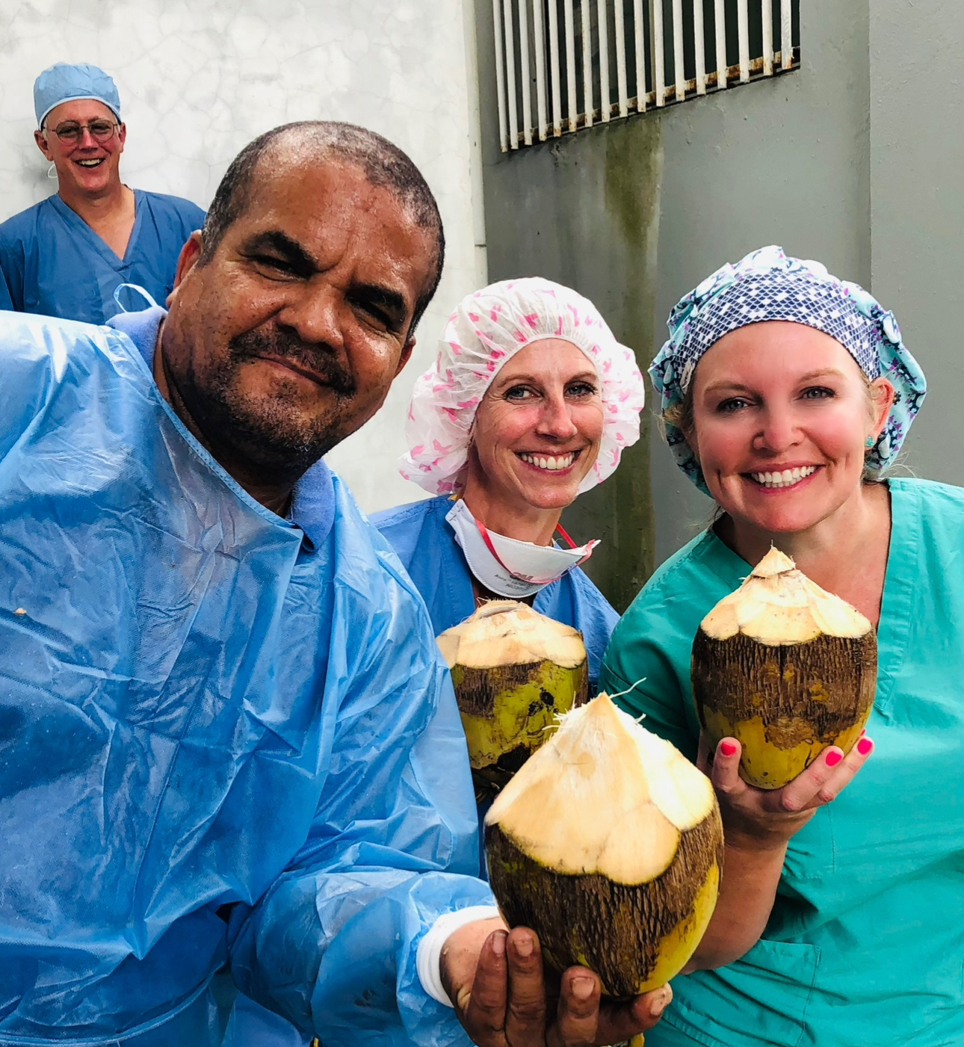

Slide 10
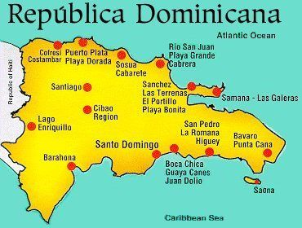
Samana, Dominican Republic

Slide 11
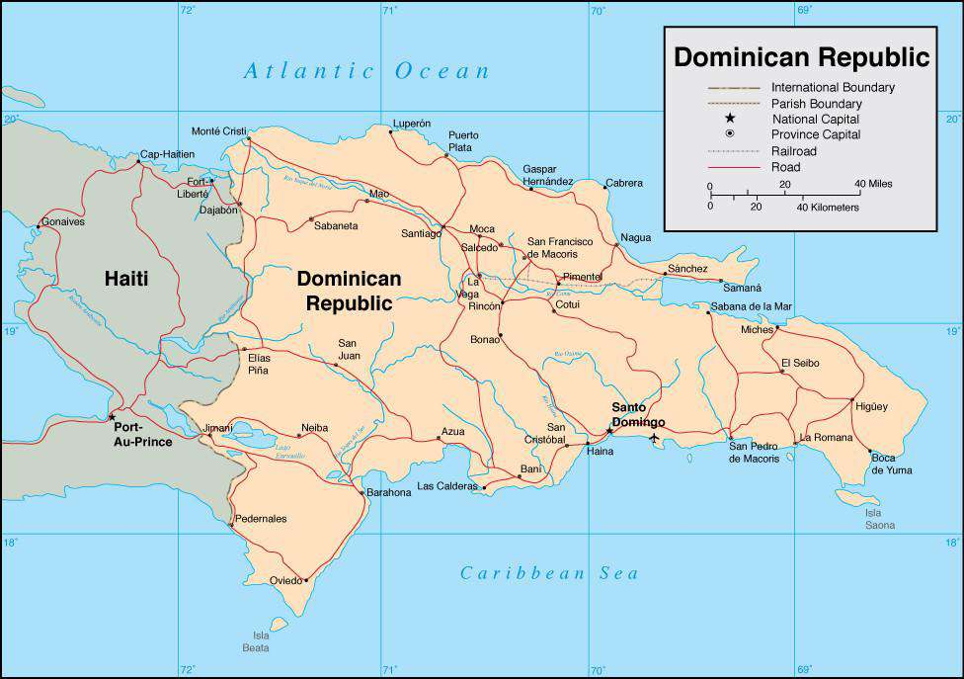

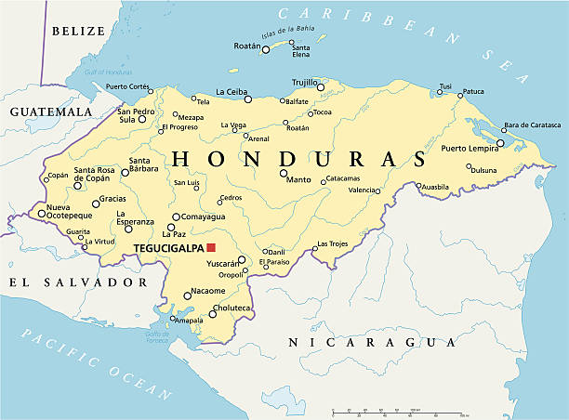




Slide 12
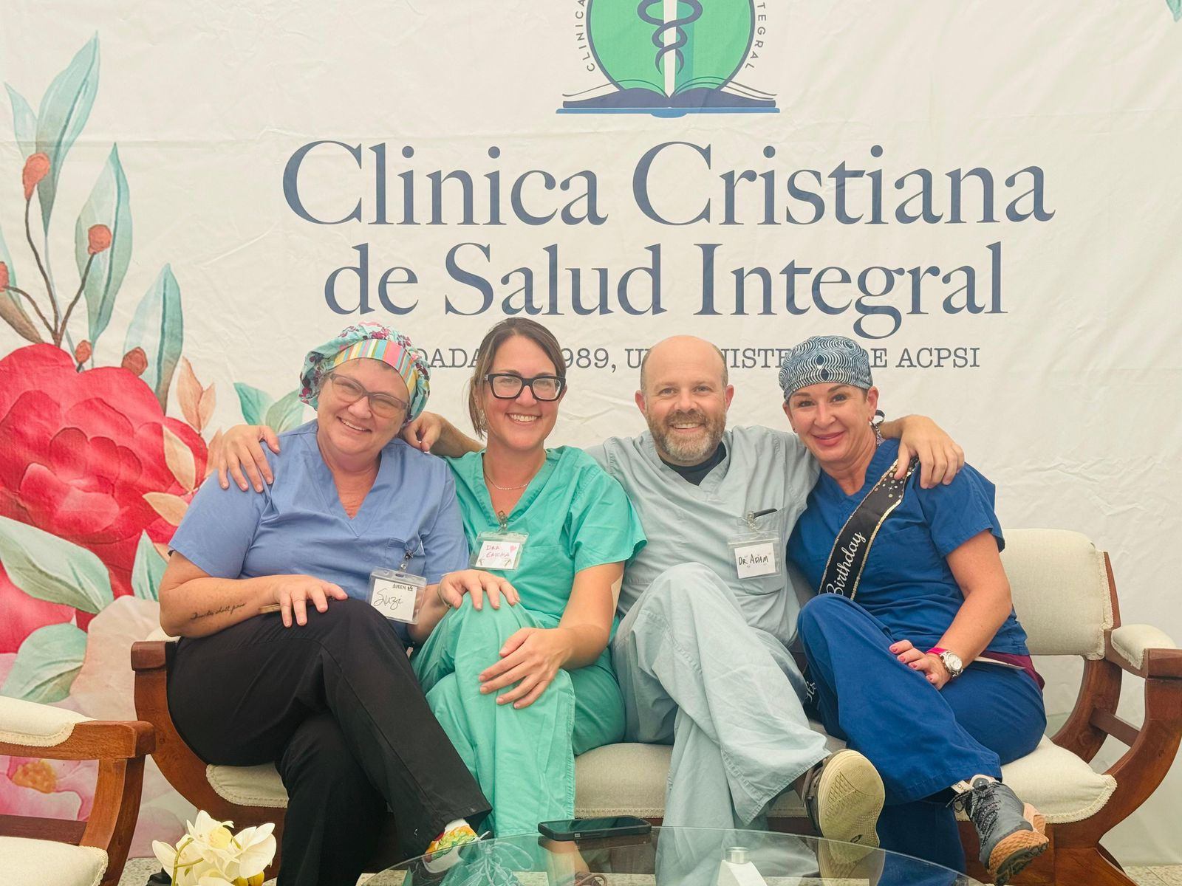

Slide 13
Some of the Stats
The number of MD’s (per 1,000 people) is 1.8 versus the 2.3 in the United States.
Rural areas have fewer physicians per 10,000 people than urban areas in the US. On average, rural areas have 13.1 physicians per 10,000 people, while urban areas have 31.2 physicians per 10,000 people.
There are 57% more hospital beds in the United States than in the Dominican.
Infant mortality is 22.8% higher in the D.R. than in the USA.
Women’s death rates are 67% (4x) the rate of the USA.
There are 5 times the number of RN’s and Midwives in the USA.

Slide 14
MORE STATS FROM W.H.O.
According to available data, in the Dominican Republic in 2023, women's health concerns included a significant rise in maternal mortality, with a reported 16% increase in maternal deaths compared to 2022, primarily attributed to direct obstetric causes like hypertensive disorders, sepsis, and complications during childbirth; this resulted in a Maternal Mortality Ratio (MMR) of 127 deaths per 100,000 live births
In the Dominican Republic, the number of additional people expected to be enjoying better health and wellbeing is projected to be ‎−0.5m by 2025 in comparison to 2018.

Slide 15
KEY BENEFITS FOR STUDENTS ON MISSION
Practical Clinical Experience
Global Health Awareness
Cross-Cultural Competence
Personal Growth
Career Exploration
Leadership Development
Resume Building

Slide 16
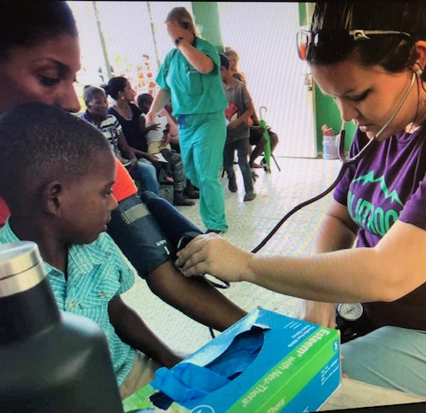
“My life was forever changed. I learned to be grateful for running water, reliable shelter and healthcare. I scrubbed everyday procedures that were life changing to our patients and often long awaited.
The people of the Dominican kept a little piece of my heart. I came home with a renewed sense of purpose and pride in my profession. I gained a better understanding of how the world works beyond my little corner of it.”
Leanne, CST
2018

Slide 17
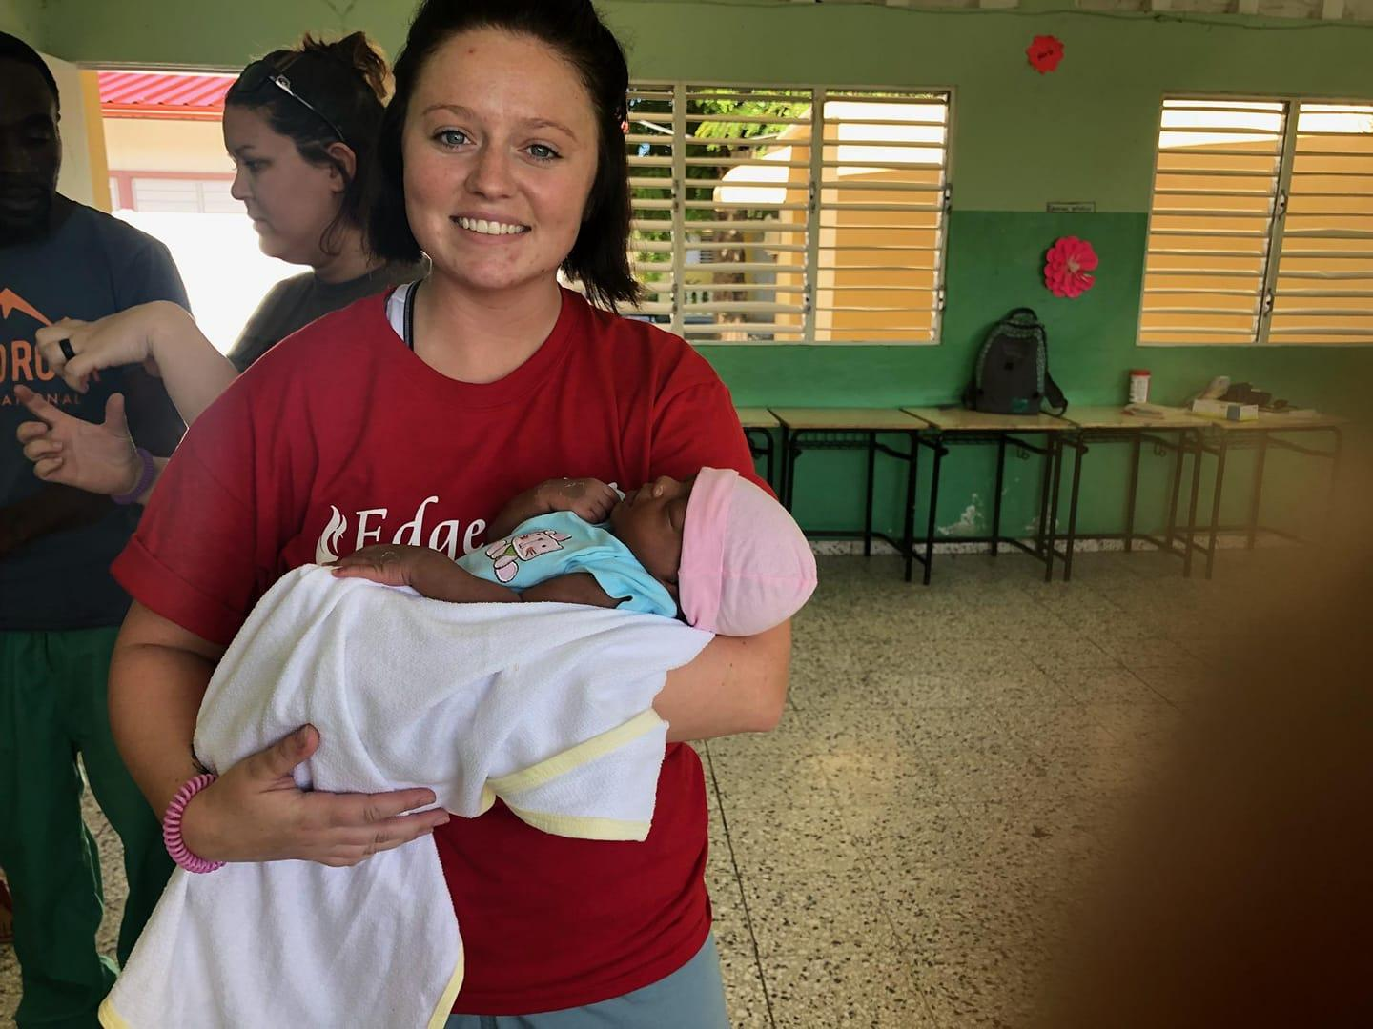
“The trip to the Dominican can be summed up to one word, humbling. I was humbled to wrap trays of surgical instruments in T-shirts versus blue sterile wrapping. I was humbled, walking down the street, seeing toddlers in the nude instead of in expensive diapers. I was humbled to see people coming to the clinic riding in on a donkey versus calling a Uber. I was humbled to see a culture that was genuinely happy, even with so little possessions.”
Connor, CST, CSFA
2018

Slide 18
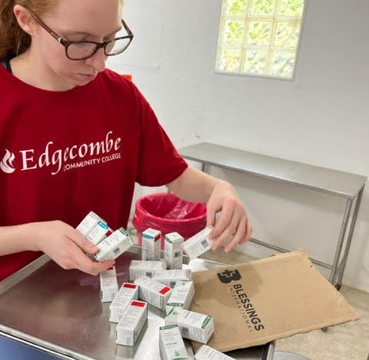
“Serving in the D.R. was humbling & inspiring. As a new tech, it gave me the opportunity to use my skills and lend a helping hand to a community that is working hard to establish access to healthcare. Helping patients with cataracts to see clearly was immensely rewarding.
I can’t wait to go again!”
Cassidy, CST
Duke Raleigh Neuro Spine Team
2023

Slide 19
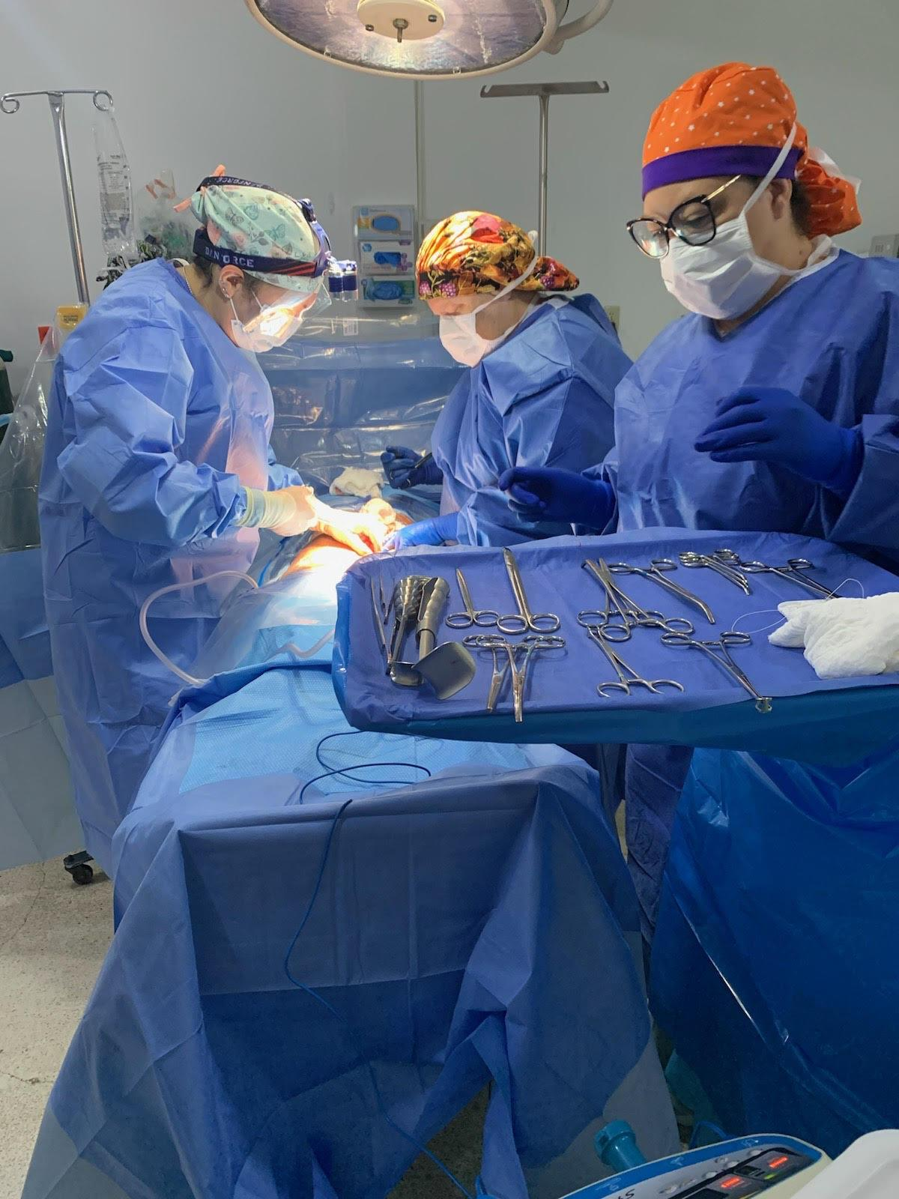
“Making this trip enriched my life more than I imagined. The clinic was filled with women who needed our help & I knew we would not be able to help all of them. These women left the next day after a TAH and we complain about a pill for a headache..
This trip left a mark on my heart & I plan on going on more trips in the future.”
Jeanette CST. (soon to be RN!)
2022

Slide 20
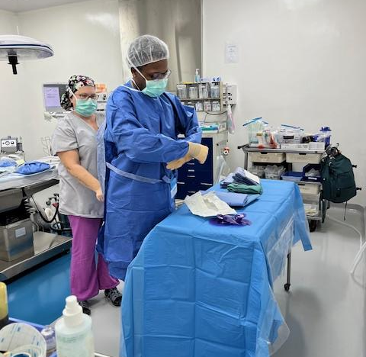
“It was
extremely rewarding to work in the operating room with a team I never worked with before. I feel very accomplished.”
Chris Lacey
2024

Slide 21
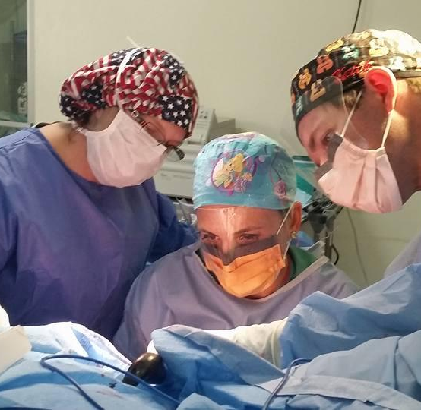
“I cannot think of a better way to emphasize the critical components of a surgical technologist’s training than to take them from the classroom and place them, not into a well-equipped tertiary care center, but into a resource-poor environment.
What better way to remind each student of the vital role they play?”
Dr. Keith Nelson, MD
Assoc. Professor, Residency Program
Director
ECU Medical Center, Greenville, NC

Slide 22
POTENTIAL FINANCING OPPORTUNITIES
For Students
College Foundation
Church
Scholarships
Letter writing campaign
Rotary Clubs

Slide 23
Skin in the Game
Student should be responsible for the following expenses:
Passport
Immunizations
Souvenirs
Transportation to & from airport home
I usually pay for luggage as these are filled with medical supplies to be utilized in country.

